Slide 1
The New Normal: How Leaders can Reset for Growth beyond Covid-19
06 September 2021 / AIO
Belhassen Tonat
E: Btonat@munichre.com

Slide 2
Agenda
01
02
The world is changing
Leaders of the future: Awareness, Agility
03
04
Major External Trends
Our eternal problems/Failures
05
06
We (Insurance) are the vaccine for economies
Flavour of the year

Slide 3
1. We feel uncomfortably comfortable
CONNECTED WORLD
ARTIFICIAL INTELLIGENCE
USER-CENTRICITY
DISRUPTIVE TECHNOLOGIES

Slide 4
2. Leaders of the Future: Hyper aware and Agile
CONNECTED WORLD
ARTIFICIAL INTELLIGENCE
USER-CENTRICITY
DISRUPTIVE TECHNOLOGIES

Slide 5
Tech Trend Radar
2. Leaders of the Future: Hyper aware and Agile
CONNECTED WORLD
ARTIFICIAL INTELLIGENCE
Artificial General Intelligence
Smart Dust
Cognitive Cyber Security
Human Enhancement
Hardware-Embedded AI
+
Smart Textiles
+
Generative Adversarial Networks
Open Data
Interpretable Machine Learning
+
HOLD
Watch list
+
Knowledge Graphs
AutoML
Autonomous Vehicles
+
Autonomous Robotics & Drones
+
Conversational Interfaces
ASSESS
Evaluation needed
Digital Twin
Machine-Driven Decisions
DISRUPTIVE TECHNOLOGIES
Deep Mapping
+
Smart Bots
Haptic Technologies
Open API
Augmented Decision Making
TRIAL
Initiatives in affected units
Quantum Computing
USER-CENTRICITY
Smart Living
NLP & Speech Recognition
Swarm Intelligence
Virtual Worlds
Digital Ecosystems
Industrial IoT
Computer Vision
5G
Augmented Worlds
Cloud Edge
Digital Health Services
Robotic Process Automation
Location-based Services
ADOPT
Start initiatives in your unit
Volumetric Display
+
Digital Identity
3D Printing
Programmable Materials
Truth Identification / Fact checking
+
New Payment Models
Cloud Enablement
Neuromorphic Hardware
Social Analytics
Distributed Ledger
Brain Computer Interface

Slide 6
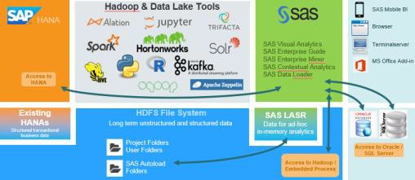
3. What are the major external trends?
TECHNOLOGICAL SHIFTS “INDUSTRY 4.0”
NEW TYPES OF RISKS
Image: used under license from shutterstock.com/Pressmaster
Image: usedunder license from shutterstock.com /Rawpixel.com
DIGITAL ECOSYSTEM
DATA & ANALYTICS

Slide 7
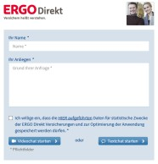
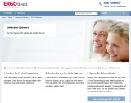
3. We focus by using a hype-cycle logic
Observe Explore
Deploy
Expectations
Connected cars
Genomics 3D scanning
Drones Autonomous
driving
3D printing
Sharing economy
Telematics
Smart factory
AI/bots
Web
analytics
IoT for B2B
Mobile/ apps
Blockchain distributed ledgers
CRM
Peer-to-peer insurance
Social media
AI underwriters
Wearables
Big data & analytics
Cyber security
Video interaction
Connected home
Innovation trigger
Peak of inflated expectations
Trough of disillusionment
Slope of enlightenment
Plateau of productivity

Slide 8
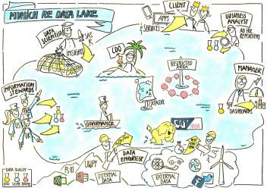
3. How Data Analytics works in insurance companies
1
2
3
4
1
Collect data
Store, cluster and structure data
3
Analyse data
4
Add value
Data lake
Client/ portfolio data
Munich Re data
External data sources
Machine learning, AI, statistics
Solution
Improve efficiency
Improve portfolio quality
Business generation
Image: used under license from shutterstock.com

Slide 9
3. Steer projects rigorously
Problem Understanding
Product-Solution Fit
Product-Market-Fit
Ideation 2.0
Ideate
Explore & Prototype
Build (MVP & Pilot)
Launch
Monetize & Scale
Learn
Measure
OKRs
Build
Opportunity Analysis
Customer Discovery
Prototype & Pilot
Market Launch
Market Scale

Slide 10
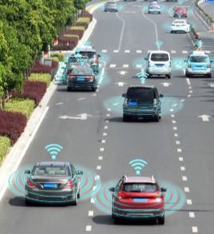
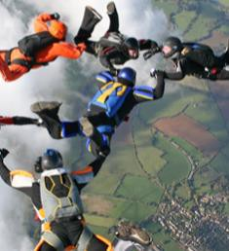
3. Cyber risk in the insurance industry
Coverage versus pace of change in technology
Managing the risk, and pricing accordingly
We’re in the risk management business
No quantum of cyber claims data
Accumulation
Image: used under license from shutterstock.com
Image: used under license from shutterstock.com
Image: used under license from shutterstock.com
Image: Getty Images
Image: used under license from shutterstock.com

Slide 11
3. A customer-centric platform
THE SOLUTION
LIFEInsurance
Life insurance
P-CInsurance
P-C insurance
Munich Re core expertise
CRITICALIllness
Critical illness
HEALTHInsurance
Health insurance
Wealth management
WEALTHManagement
External partnerships
One platform
Multiple products
Any brand
Student loans New insurance Deals and perks
FUTUREProducts

Slide 12
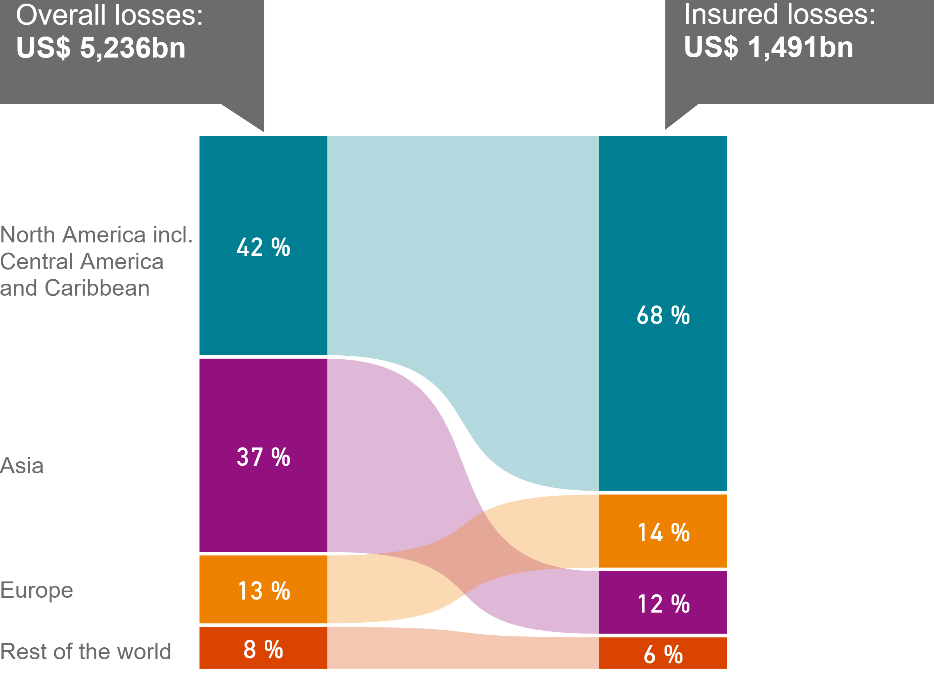
4. High share of natural catastrophe losses remains uninsured
Global losses from natural catastrophes 1980–2020
Striking insurance gap in MEA
Only 26% of Nat Cat are insured globally
Vulnerability of emerging countries to natural catastrophes is noticeably greater than that of industrialised countries
Insurance gap remains significant, higher share of insured losses for meteorological events
In Africa, less than 5% of the losses were covered by insurers,

Slide 13
4. The NatCat Insurance Gap: still a serious issue in low-income countries – but also a topic in high-income nations
Insurance gap in high-income countries*
Insurance gap in low-income countries*
Who is paying the bill?
Source: Munich Re NatCatSERVICE data (2018) *Income classification defined by World Bank: high-income countries GNI ≥ 12,736 US$; low-income countries GNI ≤ 1,045 US$

Slide 14
4. Divergent recoveries in 2021: US and China ahead– Emerging markets lagging behind
Annual real GDP growth 2020 – 2022 (in %, baseline scenario)
10,0
8,0
6,0
4,0
2,0
0,0
-2,0
-4,0
-6,0
-8,0
-10,0
9,1
8,4
7,0
7,0
7,1
_{6,6}6,9
6,0
5,8
5,7
5,3
4,5
4,1
4,4 4,5
4,2
_{3,6}4,0
3,3
3,0
3,4
2,5
2,3
-3,6
-3,5
-3,8
-4,9
-4,7
-4,8
-6,6
-7,0
-7,0
-9,8
World
US
UK Eurozone Germany
Japan
China
India
Emerging Asia (excl. China)
Latin America
Sub Saharan Africa
2020 2021
2022
Source: Munich Re Economic Research
10

Slide 15
4. Very strong economic policy reaction, but not in Africa!
G20: Fiscal measures (% of GDP)
COVID-19 additional revenue and spending measures 2020 and 2021 (in % of 2020 GDP)
“American
9,0
8,0
7,0
6,0
5,0
4,0
3,0
2,0
1,0
0,0
Other G20 G7
8.6
25 Rescue Plan“
(~ 10% of GDP)
6.5
20
4.5
6,2
15
3.5
4,3
3,9
2.1
10
1.7
2,3
0.5
0,3
5
0,9
0,7
Dec-20
2008 2009 2010
Global financial crisis
0
Apr-20 Jun-20 Sep-20
MEX
TUR SAU IND ARG RUS KOR IDN CHN ZAF ESP FRA ITA BRA G20 DEU CAN JPN AUS GBR USA
COVID-19
11

Slide 16
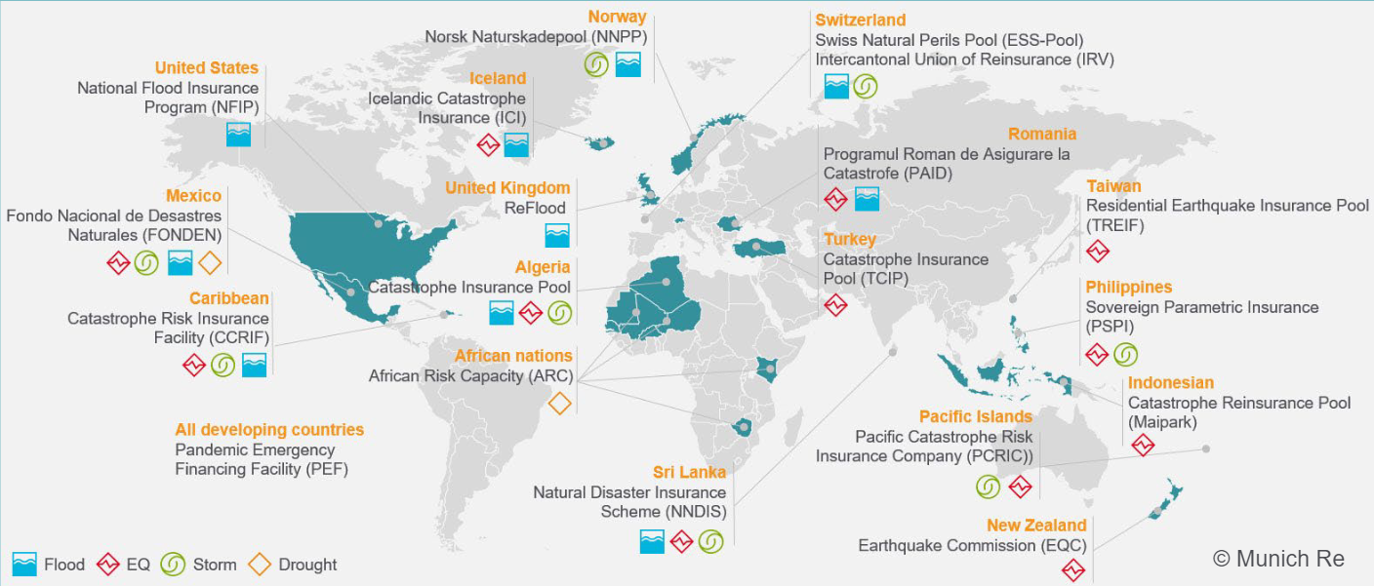
5. “Enabling”: Public-private partnership solutions improving insurability in high risk areas and reducing the insurance gap
Flood Re
Morocco Cat Pool

Slide 18
6. Flavour of the year…
Change in working mode:
Hybrid working styles will emerge; productivity increases visible
Climate risks
Increasing awareness of risk and need of change post Paris Agreement COP21 ff
New office space strategies:
Post-Covid19 workplace strategies with different real estate needs (e.g. less inner city office space needs)
Usage of digital tools rising:
Digital tools (e.g. for claims adjustment, internal inspection, etc.) are on the rise
Focus on cyber business:
Increased need for cyber security coverages & adequate IT architecture
Business Interruption covers:
Retroactive change of policy language and proactive development of future pandemic solutions
Notes:
The importance of the emerging countries for the global economy has continued to rise in the last decade. Whilst in the 1990s they accounted on average for 26% of global GDP growth, in the first decade of the 21st century the figure rose to 56% (49% if the effects of the recession in 2009 are disregarded). And what is more, though in previous decades the emerging countries had been looked upon as hotbeds of instability, prominent exam-ples being the hyperinflation in Latin America and the crises in Asia and
Reasons for the economic success of the emerging countries
The average very high economic growth in the emerging countries is due to a wide range of factors, for example:
• The large technological lead of the industrialised countries creates potential for production technologies to be transferred at relatively little cost to the emerging countries, generating rapid growth in productivity. Foreign capital is available to finance the required investment.
• Emerging countries are able to offer highly competitive prices, partly due to arti-ficial undervaluation of their currencies, which supports the dynamic develop-ment of exports as an important driver of economic growth.
* Income per capita, and hence private consumption, is initially very low, but as soon as the budding growth produces increased incomes, consumer demand rises rapidly.
• Increasing political and social stability and fewer sovereign debt problems re-duce vulnerability to (economic) crises, thus fostering continuous growth.
• Reforms are implemented to create a better environment for economic growth, for example investment in infrastructure and education or liberalisation of prod-uct markets.
Russia, the vast majority of them actually proved to be bastions of stability for the global economy during the US subprime crisis and the government debt and banking crisis in the eurozone.

Slide 19
Thank you very much for your attention!

Slide 20
Disclaimer
© 2021 Münchener Rückversicherungs-Gesellschaft Aktiengesellschaft in München ("Munich Re"). All rights reserved.
The content of this presentation (including, without limitation, text, pictures, graphics, as well as the arrangement thereof) is protected under copyright law and other protective legislation. These materials or any portions thereof may be used solely for personal and non-commercial purposes. Any other use requires Munich Re’s prior written approval.
Munich Re has used its discretion, best judgement and every reasonable effort in compiling the information and components contained in this presentation. It may not be held liable, however, for the completeness, correctness, topicality and technical accuracy of any information contained herein. Munich Re assumes no liability with regard to updating the information or other content provided in this presentation or to adapting this to conform with future events or developments.

