Slide 1
The role of agricultural insurance in contributing to improved food security and role of regulation
AIO Microinsurance workshop 2023
Lulama Mafunda I 30 May 2023

Slide 2
Agenda
1| The role of A2ii
2| What regulators can do to promote inclusive insurance growth in SSA
3| Tracking inclusive insurance regulation
4| How agricultural insurance can improve food security
5| Role of Regulators: Agricultural Insurance/Index Insurance
6| Regulatory challenges

Slide 3
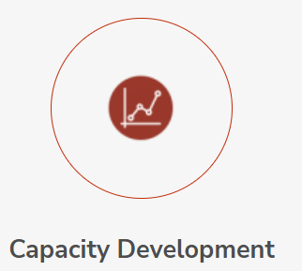

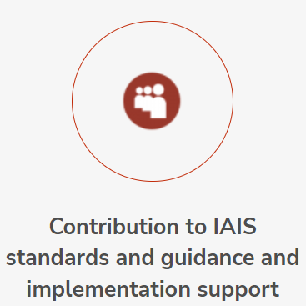
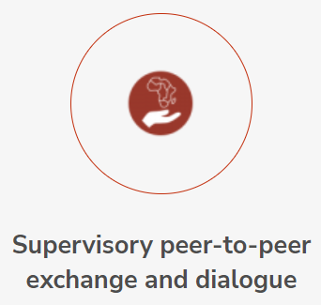
1. The role of A2ii
Strengthen the capacity of supervisors. Help supervisors where there is a need for insurance, barriers and guide them in identifying solutions
Feed learning back to IAIS Standard setting and implementation activities and provide inputs to the development of global standards and guidance. Support country implementation in regulatory and supervisory reform
Facilitate peer exchange and
dialogue through innovative
platforms.
Provide knowledge that the supervisors need to regulate and supervise insurance markets in a manner that promotes greater access to insurance for low income consumers

Slide 4
2. What regulators can do to promote inclusive insurance growth in Sub-Saharan Africa
Microinsurance
“Insurance that is accessed by the low-income population, provided by a variety of different entities, but run in accordance with generally accepted insurance practices.” (IAIS, 2007)
Inclusive Insurance
“All insurance products aimed at the excluded or underserved market, rather than just those aimed at the poor or a narrow conception of the low-income market.” (IAIS, 2015)

Slide 5
2. What regulators can do to promote inclusive insurance growth in Sub-Saharan Africa
Introduction and implementation of inclusive insurance legislation
Inclusive insurance is anchored in proportionality
  Apply principles of proportionality in regulatory frameworks
  Reduction of regulatory burden
    reduces capital and governance requirements for microinsurers
    simplified reporting requirements

Slide 6
3.Inclusive insurance regulation in 2009
6
^{ASIA-PACIFIC}
^{India}
^{China}
^{Philippines}
^{Chinese Taipei}
^{LATIN AMERICA & CARIBBEAN}
^{Peru}
^{Mexico}
^{IMPLEMENTED}

Slide 7
3. Inclusive insurance regulation in 2023
17
38
^{ASIA-PACIFIC}
^{Bangladesh}
^{Fiji}
^{Papua New Guinea}
^{Sri Lanka}
^{Vietnam}
^{LATIN AMERICA & CARIBBEAN}
^{Chile}
^{Colombia}
^{El Salvador}
^{Guatemala}
^{Honduras}
^{Jamaica}
^{MIDDLE EAST & NORTH AFRICA}
^{Jordan}
^{Morocco}
^{Palestinian Territories}
^{Tunisia}
^{United Arab Emirates}
^{SUB-SAHARAN AFRICA}
^{Namibia}
^{ASIA-PACIFIC}
^{Cambodia}
^{China}
^{Chinese Taipei}
^{India}
^{Indonesia}
^{Malaysia}
^{Mongolia}
^{Nepal}
^{Pakistan}
^{Philippines}
^{Thailand}
^{LATIN AMERICA &}
^{CARIBBEAN}
^{Argentina}
^{Belize}
^{Bolivia}
^{Brazil}
^{Costa Rica}
^{Mexico}
^{Nicaragua}
^{Paraguay}
^{Peru}
^{Venezuela}
^{MIDDLE EAST &}
^{NORTH AFRICA}
^{Egypt}
^{IMPLEMENTED}
^{UNDER DEVELOPMENT}
^{SUB-SAHARAN AFRICA}
^{CIMA*}
^{Eswatini}
^{Ethiopia}
^{Ghana}
^{Kenya}
^{Lesotho}
^{Madagascar}
^{Malawi}
^{Mozambique}
^{Nigeria}
^{Rwanda}
^{South Africa}
^{Tanzania}
^{Uganda}
^{Zambia}
^{Zimbabwe}
* CIMA is counted as one jurisdiction (Benin, Burkina Faso, Cameroon,
Central African Republic, Chad,
Congo, Equatorial Guinea, Gabon,
Guinea Bissau, Ivory Coast, Mali,
^{Niger, Senegal, and Togo)}
Notes:
The most recent updates include:
2022: Bolivia, Colombia, Morocco, Nepal, Paraguay, Vietnam
2021: Brazil, Chinese Taipei, Egypt, Ghana, Pakistan, Lesotho, Malaysia, Namibia, Zambia
2020: Costa Rica, Ethiopia, Eswatini, Kenya, Madagascar, Mongolia, Mozambique, Nepal, Nigeria, Puerto Rico, South Africa, UAE, Uganda
2019: Argentina, Fiji, India, Malawi, Papua New Guinea, Peru
2018: Cayman Islands, Chinese Taipei, Indonesia, Rwanda, Zimbabwe

Slide 8
4. How agricultural insurance can improve food security
Insurance can contribute to achievement of Sustainable Development Goals (SDGs)
  SDG 1: No poverty
  SDG 2: Zero hunger
Protects farmers from losses emanating from adverse weather events
Allow farmers to access credit markets
Better management of risk contributes to food security

Slide 9
5. Regulators Role: Agricultural Insurance and Index insurance
Enable and support market development
Regulation is essential for creating opportunities for innovation.
  Regulatory Sandboxes
  Innovation Hubs
Regulators may consider enforcing mandatory provision of certain types of insurance
Consider how to reduce cost of compliance to allow for affordable insurance solutions
Consider Supervisory KPIs Lexicon for SSA – SDG Pillar.
  Measures Impact Story, Product, Corporate Citizen
Supervisory KPIs Lexicon | Access to Insurance Initiative (a2ii.org)

Slide 10
6. Regulatory Challenges : Sub – Saharan Africa
Regulatory framework not allowing for index-based agricultural insurance (not considered to be insurance)
Products still in pilot stage
Need for government support to subsidize premiums
No guidance yet from IAIS on regulating index insurance
Low penetration of agricultural insurance

Slide 11


Thank you.
Follow us on Twitter @a2ii_org, YouTube and LinkedIn

