Slide 1
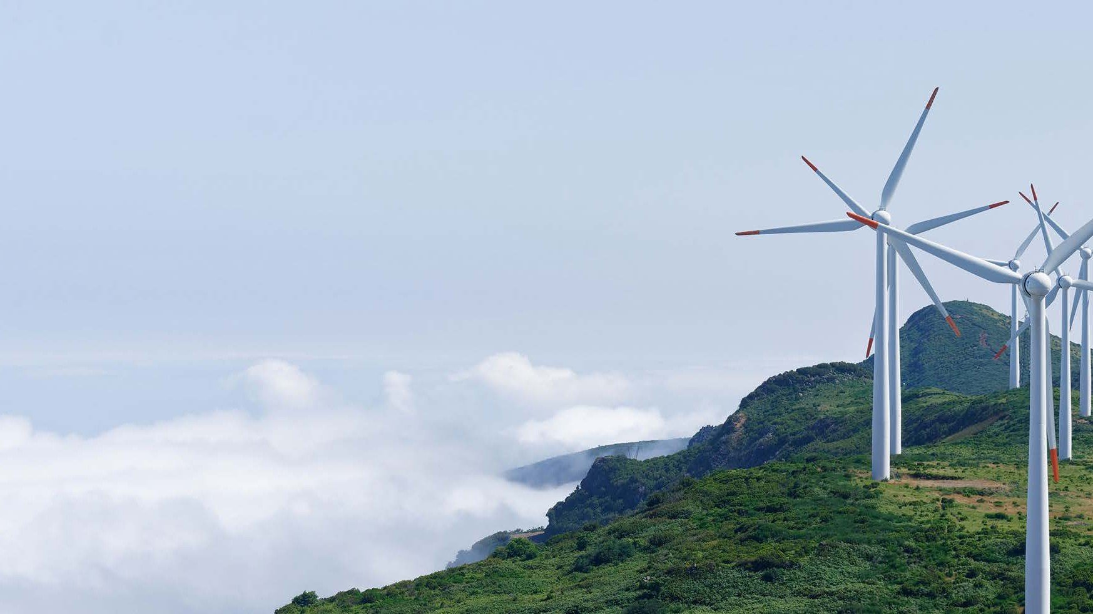
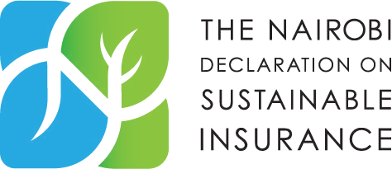
Leadership with a long-term view The role of the insurance industry in driving a sustainable future
29th MAY 2023
Elias Omondi
Principal – Innovation for Resilience

Slide 2
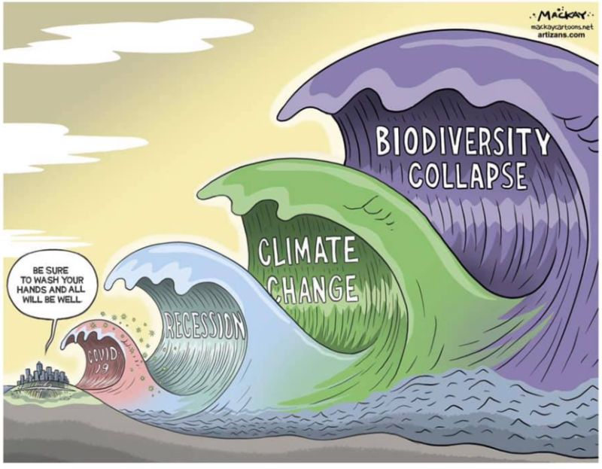

Slide 3
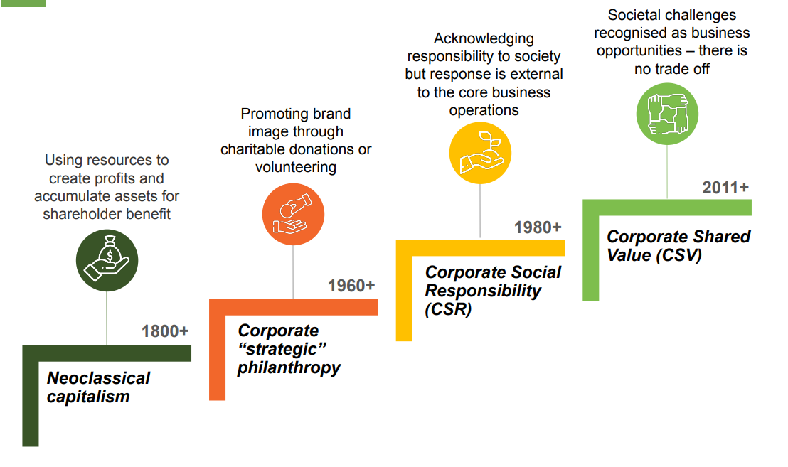
The role of business has evolved
Sources: 1. Samans, R. and Nelson, J. (2020). Walking the Talk of Stakeholder Capitalism. | 2. Godfrey, P. C. and Hatch, N. W. (2007). Researching Corporate Social Responsibility: An Agenda for the 21st Century. | 3. Smith, N. C. (1994). The New Corporate Philanthropy, Harvard Business Review

Slide 4
Climate and nature-related risks dominate the global risk register
Top 5 Global Risks in terms of likelihood
 | 2019 | 2020 | 2021 | 2022 | 2023
1 | Extreme weather | Extreme weather | Extreme weather | Climate action failure | Failure to mitigate climate change
2 | Climate action failure | Climate action failure | Climate action failure | Extreme weather | Failure of climate change adaptation
3 | Natural disasters | Natural disasters | Human-made environmental damage | Biodiversity loss | Natural disasters and extreme weather
4 | Data fraud or theft | Biodiversity loss | Infectious diseases | Social cohesion erosion | Biodiversity loss
5 | Cyberattacks | Human-made environmental disaster | Biodiversity loss | Livelihood crises | Large scale involuntary migration
Economic
Environmental
Geopolitical
Societal
Technological

Slide 5
Africa is in a perilous climate position
Africa’s contribution to global emissions is minimal, yet economic and geographic factors make it the most climate vulnerable continent
30 of the world’s 40 most climate vulnerable countries are in SSA
GDP of African nations is very exposed to extreme climate patterns
Africa’s GDP could be down by up to 30% by 2050
Some countries are already incurring losses up to 10% of their GDP
23% of Africa’s GDP is dependent on nature
But - currently only 3% of global green finance goes to Africa!

Slide 6
The African Context
1 | 2 | 3
Africa has a large stock of natural capital Africa has 30% of the world’s minerals, offering large natural capital opportunities (UNEP) Africa contains 65% of the worlds’ arable land (UNEP) Africa’s living organisms comprise 25% of global biodiversity and is home to the world’s second largest rain forest | Africa is highly dependent on nature 62% of Africa’s GDP is dependent on nature (WEF, 2020) Over 70% of people living in sub-Saharan Africa depend on forests and woodlands for their livelihoods (UNEP) In most African countries, natural capital accounts for between 30-50% of total wealth (UNEP) | Nature is being depleted rapidly across the continent Each year, Africa loses an estimated $195bn of its natural capital (UNEP) Between 2001 and 2020, several African countries lost up to 30% of their tree cover, compared to 11 percent globally

Slide 7
How climate change threatens the financial sector
‘Climate change is a source of structural change in the economy and financial system and therefore falls within the mandate of central banks and supervisors’ – Network for Greening the Financial System
Financial contagion (market losses, credit tightening) feeding back to the economy
Physical risks
Extreme weather events
Gradual changes in climate
Economy
Financial system
Direct transmission channels
Business disruptions
Underwriting losses
Capital scrapping
Lower commercial property values
Operational risks (including liability risks)
Climate Risks
Transition risk drivers
Climate policy
Technology
Consumer preferences
Liability
Migration
Lower residential property values
Reconstruction, reinvestment and replacement
Financial market losses (equity, bonds and commodities)
Lower corporate profitability and increased litigation
Increase in commodity and energy prices
Liability risks
Risk of people seeking compensation from physical and transition risks
Corporate assets devaluation
Credit markets losses (residential and corporate loans)
Standard assets (fossil fuels, infrastructure, real estate, vehicles)
Indirect transmission channels
Economic deterioration (lower demand and output) impacting financial conditions
Source: GCF October 2020, Bank of England

Slide 8
Leadership with a long-term view is essential for driving a sustainable future
Understanding Risk
Mitigating Risk
Supporting Sustainable Development
The insurance industry is uniquely positioned to understand and assess risk, making it a powerful tool for promoting sustainability.
Insurers in Africa can encourage sustainability by offering lower premiums to clients who adopt environmentally-friendly practices or invest in renewable energy.
Encouraging Resilience
Insurers can support sustainable development by investing in green bonds, which finance environmentally-friendly projects.
Being a Role Model
Insurers can encourage resilience by offering policies that incentivize clients to adopt measures that mitigate the impact of natural disasters.
The insurance industry can lead by example, adopting environmentally-friendly practices in its own operations.

Slide 9
Why is Leadership Important?
Bulk of natural disaster losses remains uninsured - In 2020, the insured losses from natural catastrophes in Africa were roughly 10% i.e. $2.4 billion, highlighting the need for risk mitigation strategies.
Greening the Financial System - In 2021, the African green bond market reached $7 billion against a world green bond market of $270 billion , highlighting the growing importance of sustainable investing.
Sustainable insurance products - In 2020, renewable energy investments in Africa totalled $6.5 billion, with insurers playing a significant role in financing these projects
Sustainable Strategies - In 2021, 33% of African insurers reported having a sustainability strategy in place, with many setting ambitious targets for reducing their carbon footprint.

Slide 12
The Future is Sustainable Insurance
Sustainable insurance is a strategic approach where all activities in the insurance value chain, including interactions with stakeholders, are done in a responsible and forward-looking way by identifying, assessing, managing and monitoring risks and opportunities associated with environmental, social and governance issues.
Sustainable insurance aims to reduce risk, develop innovative solutions, improve business performance, and contribute to environmental, social and economic sustainability.

Slide 13
Thanks!

