Slide 1
AIO - MORTALITY TABLES
Laura Llewellyn-Jones FIA FNAS
Algeria
29 May 2023

Slide 2
Who we are
Team Leaders:
Laura Llewellyn-Jones FIA FNAS Director of Callund Consulting Limited currently based in Nigeria. Laura has been focused mainly on African clients for over a decade, and has lived in East, West & South Africa
Rosemary Nantambi, BStat Director of Callund Consulting Limited, Director of African Operations, based in Kampala, with over 20 years pensions and actuarial consulting experience
Jon Palin FIA Partner and Senior Longevity Consultant at Barnett Waddingham LLP in the UK. He advises a range of clients on longevity, including base mortality assumptions and variations between different populations, and mortality projections, including stochastic models
In addition, we have additional team leaders who are qualified actuaries, as well as a team of analysts who specialise in mortality and morbidity tables, and who work closely with the Continuous Mortality Investigation (CMI) in the UK

Slide 3
Recent experience
Supporting the Continuous Mortality Investigation (CMI) owned by IFOA (BW)
Mortality Tables for Egypt (BW), the first mortality tables for the industry
Mortality Tables for Kazakhstan (CCL, BW), this included mortality experiences for various subsets of the population
Mortality Tables for Rwanda (CCL, BW), first industry tables
Old Age Mortality (BW) advising several UK insurance companies on mortality assumptions at older ages where there is limited reliable data
Stochastic models and Solvency II (BW) – assisting a major insurer to review existing stochastic longevity models (used for its capital requirements)

Slide 4
Importance of Mortality Tables
Robust and relevant mortality tables allow more accurate actuarial modelling and reserving, which will better protect policyholders
Increase trust within these industries
They can enhance product development, as well as creating more stability as companies are better able to manage their risks
Out of date, irrelevant or inaccurate mortality tables can impede the expansion of the industry by forcing additional risk loadings to be included in the premium pricing

Slide 5
Why new Tables?
Mortality Tables are an essential, if somewhat hidden, part of the life and social insurance infrastructure in every country where there are life and retirement products
The existence of local tables that are kept up-to-date aid credibility and growth of the life and retirement sectors
Life expectancy has changed significantly over time as well as between different countries. Detailed analysis by ‘Our World in Data’ – which sources data from the United Nations, Department of Economic and Social Affairs, Population Division (2022), World Population Prospects 2022, Estimates of Regional and Global Life Expectancy 1800-2001, Population Development Review 31(3)

Slide 6
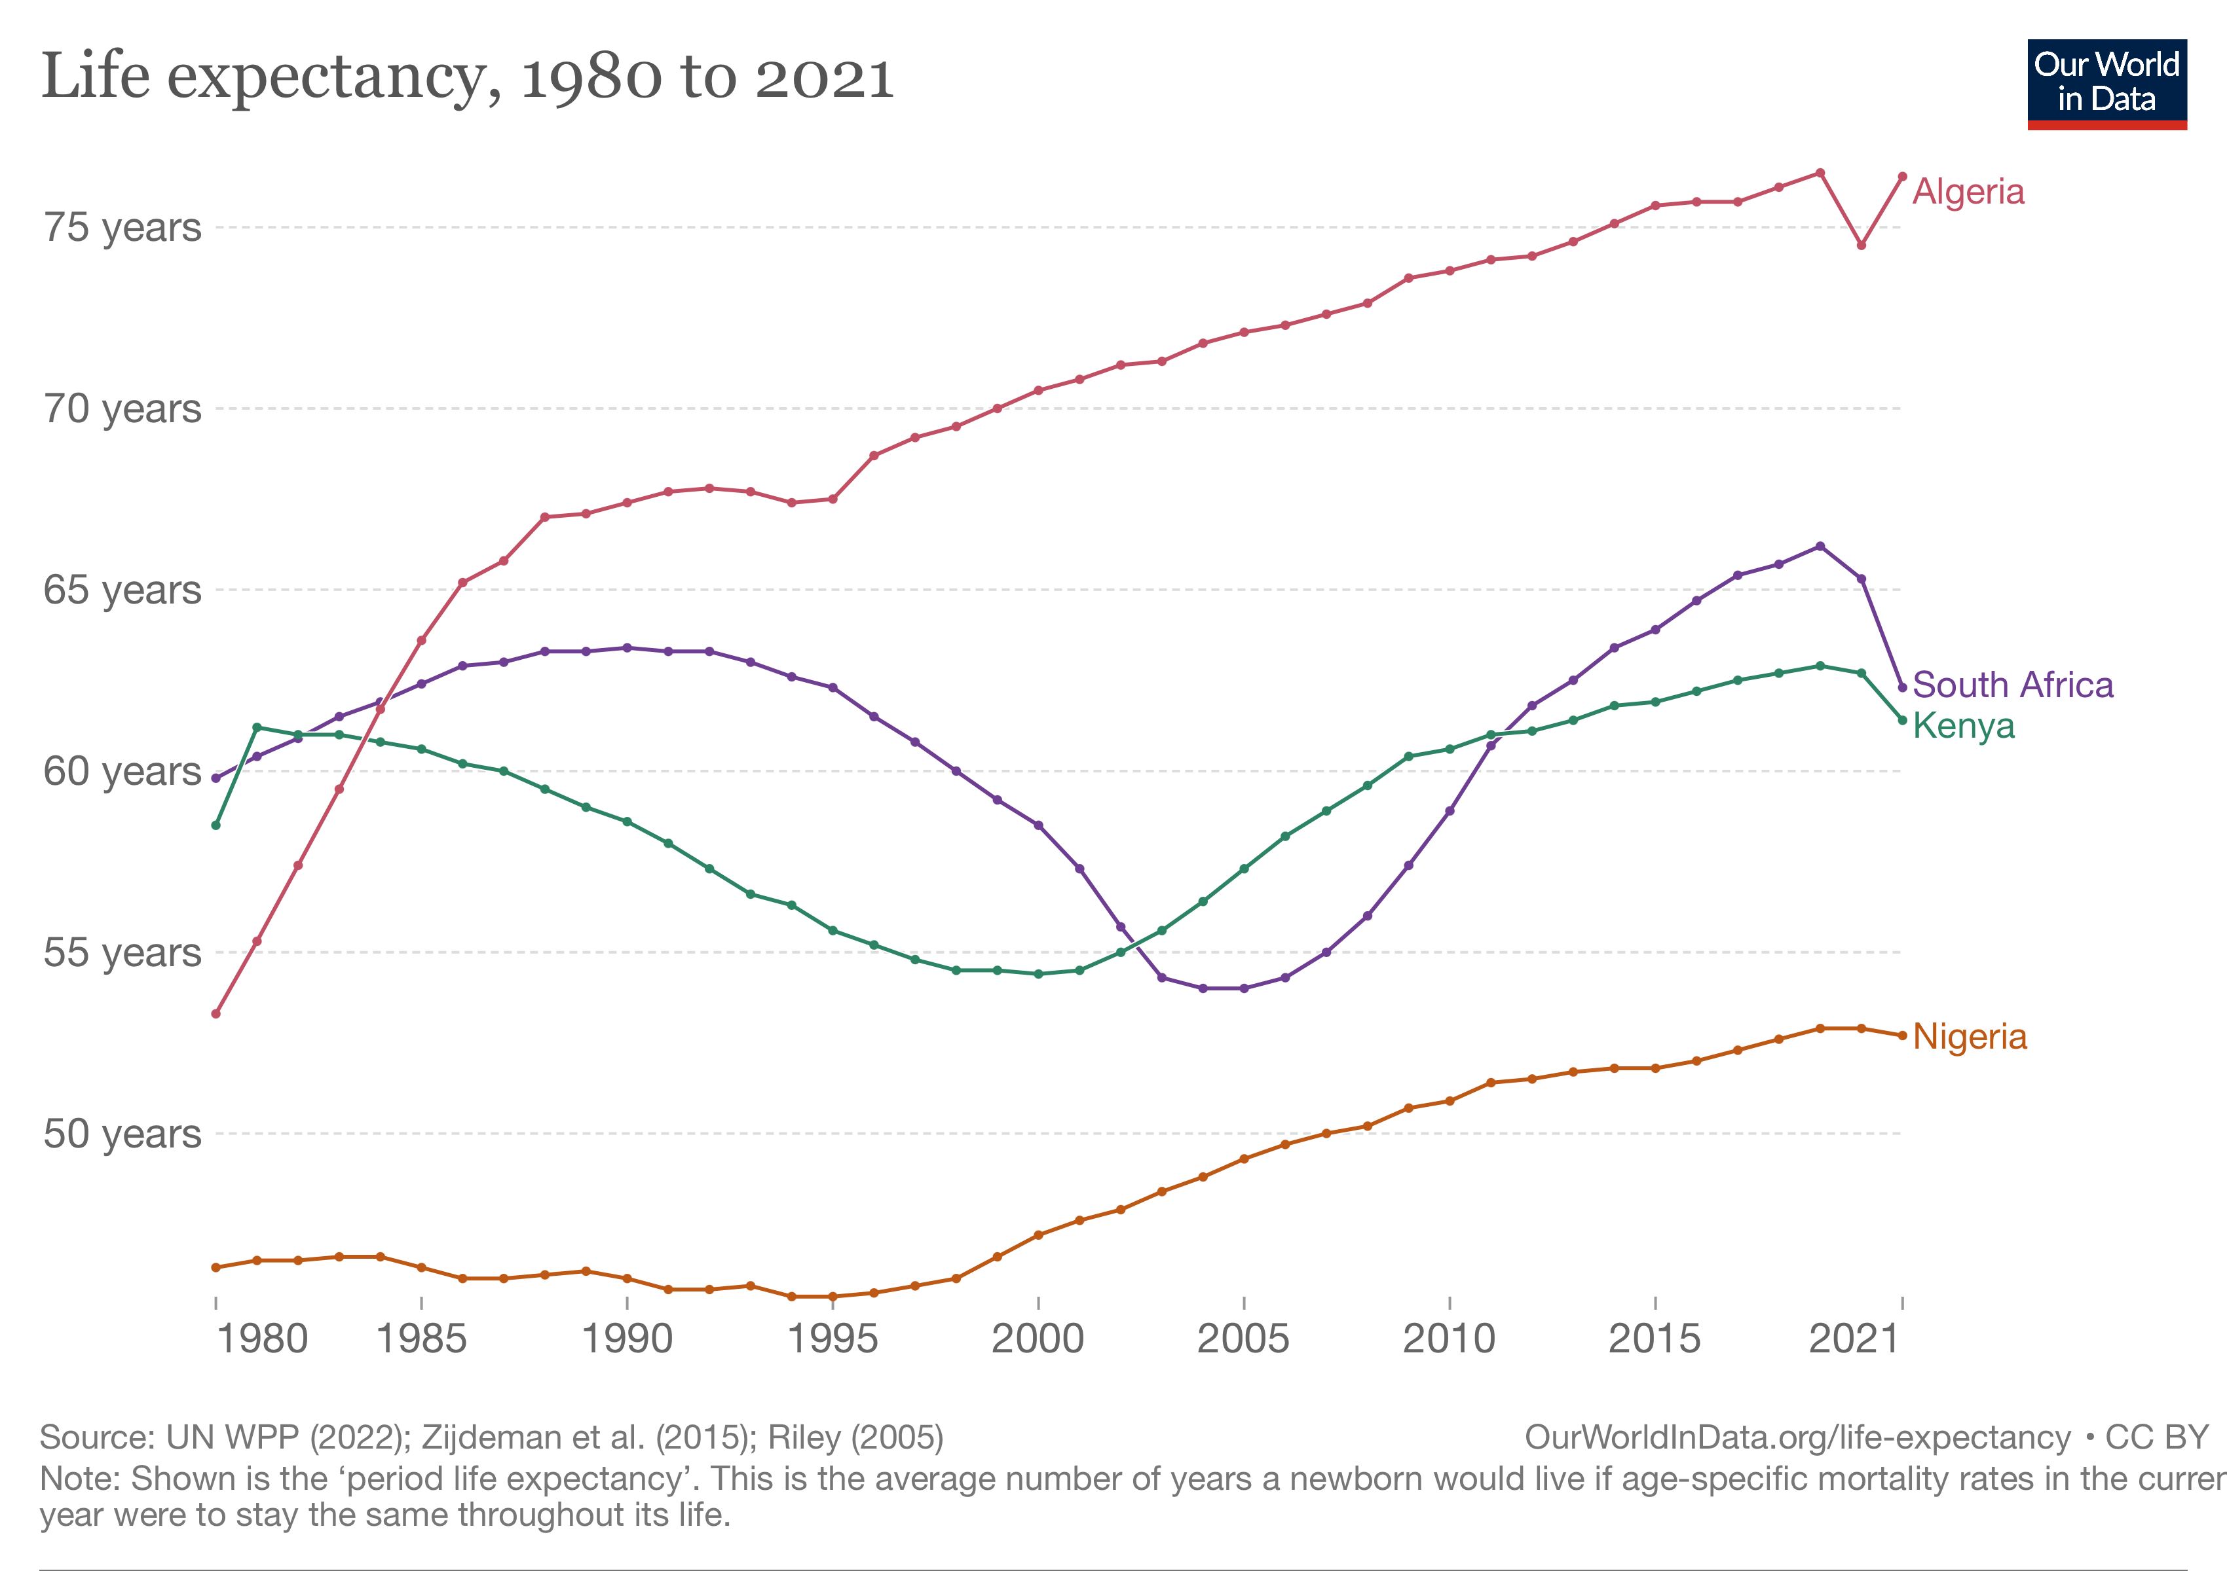
Our World in Data
Graph illustrates life expectancy differences between 1980 and 2021
Algeria: 53.3 to 76.4 (+23.1)
South Africa: 59.8 to 62.3
(+2.5)
Nigeria: 46.3 to 52.7
(+6.4)
Kenya: 58.5 to 61.4
(+2.9)

Slide 7
Example – pandemic
Comparing experience in 2019 with 2020 (large pension plan in Ecuador):
Analysing Actual over Expected deaths – can illustrate how well a mortality table fits the policy/ membership data
The table used here in 2019 is a reasonable fit, except at older ages (over 90) where there is less data

Slide 8
Example – pandemic
Comparing experience in 2019 with 2020:
Data from 2020 shows higher deaths than expected from the standard table
International experience has shown excess deaths have continued after the pandemic – detailed analysis is looking at factors which have impacted this – such as pressure on health systems, delayed care, less screening/ preventative care – however we would expect the data to return to the pre-pandemic state

Slide 9
Importance of Data
One of the biggest challenges is obtaining sufficient data of a high quality in order to achieve statistically credible results
We have experience in working with challenging data sets, however the better the quality of the data, the more accurate the tables will be
We would also compare our findings with other relevant tables
e.g. UK, South Africa, Egypt, CIMA, Kenya, Uganda, Rwanda and others

Slide 10
Considerations
Which tables are required?
base mortality/ allowance for improvements
policy (e.g. term assurance/ whole of life)
additional tables such as disability/ critical illness
Other subsets
Where to get data from?
life companies
pension/ social security schemes
How to validate the data?
comparisons with historic data/ national data/ similar countries

Slide 11
Data Requirements
Individual policy/member records:
Date of Birth, Date of Joining, Date of Exit (if applicable)
Type of Exit (if applicable)
Gender
Factors to enable mortality to be considered for subsets of the population (for example):
Policy Type
Policy Amount
Socio-economic data

Slide 12
Timelines
Initial preparation
Project administration
Discussions with stakeholders
Data requests
Workshops/ project outline
Data phase
Collection of data
Data analysis/ data queries
Data summary
Analysis
Results
Workshops/ Launch

