Slide 1
Africa Insurance Pulse 2023 Food security and agricultural insurance in Africa
Algiers, Algeria, 30 May 2023
Simone Lauper, Faber Consulting AG

Slide 2
The 2023 edition of Africa Insurance Pulse is dedicated to food security
Introductory remarks and methodology
Since 2016, the African Insurance Organisation has published 12 editions of Africa Insurance Pulse on a range of topical issues
The publication highlights the impact of food security on Africa, and the vital role of agricultural insurance in promoting sustainable growth and addressing food insecurity
The findings are based on research, a series of in-depth interviews with senior executives and an online survey of practitioners working in Africa
Faber Consulting AG prepared this publication for the 49th Conference and Annual General Assembly of the African Insurance Organisation

Slide 3
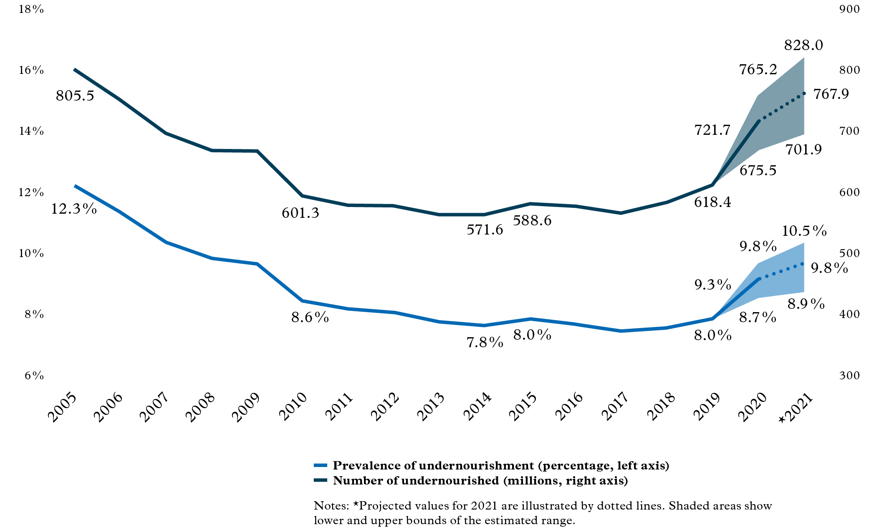
Global hunger is rapidly increasing
Prevalence of undernourishment, as reported by the FAO for 2005 to 2021
According to the Food and Agriculture Organization of the United Nations (FAO), the number of hungry people in the world is estimated to have risen to between 702 million and 828 million in 2021

Slide 4
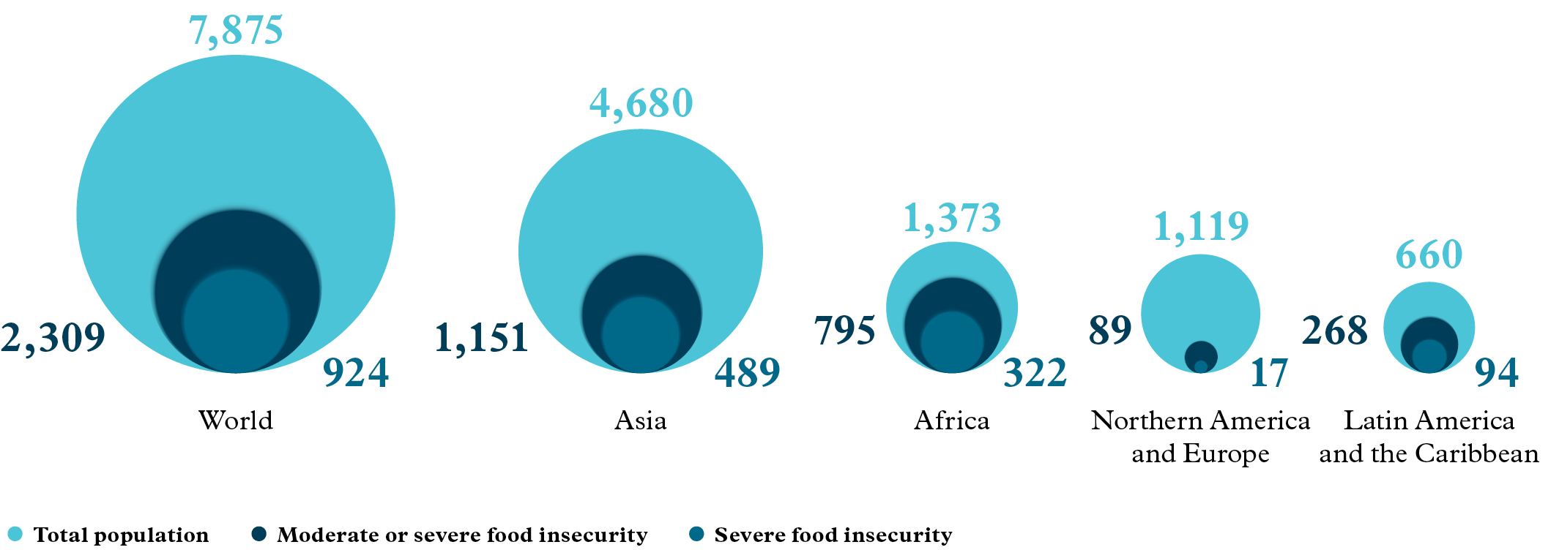
Africa bears highest burden of food insecurity relative to population size
FAO-reported food insecurity by severity, globally and by region in 2021 (in millions of people)

Slide 5
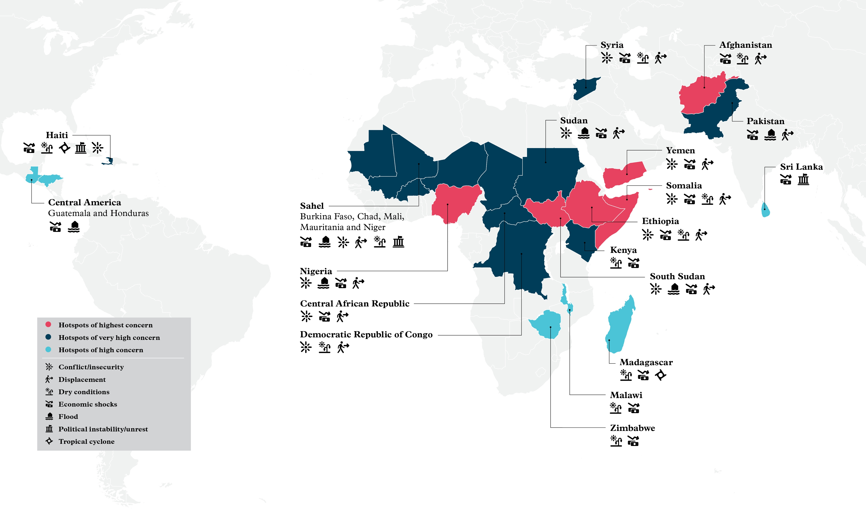
Africa was bearing the heaviest burden of food insecurity in 2021
Food insecurity in Africa is increasing due to a combination of risk factors
Acute food insecurity hot spots based on FAO projections for 2022/2023
Food insecurity as reported by the FAO, by level of severity, globally and by region in 2021

Slide 6
Agricultural insurance protects incomes and fosters investment in food security
How agricultural insurance contributes to food security
Income stability
Protects farmers from risks, providing financial stability and enabling recovery from losses to maintain food production
Rural economic development
Safeguards employment opportunities for farmers, reducing rural-urban migration
Building resilience to climate change
Helps farmers adapt to the risks of global warming by financing new technologies and practices
01
02
03
Financial inclusion Increases farmers' access to credit to invest in their businesses
Higher productivity Encourages investment in agriculture by providing certainty to investors, leading to improved productivity and food production
Better risk management
Insurers work with farmers to promote new technologies that reduce risk and increase productivity
04
05
06

Slide 7
The remarkable growth potential of global agricultural insurance
2020 global premiums for non-life insurance and agricultural insurance
The global agricultural insurance market has grown significantly due to the increasing frequency and severity of weather-related events affecting agriculture
Swiss Re estimates the value of the global agricultural insurance market at USD 46 billion in 2020
The market is forecast to reach USD 80 billion by 2030, growing at a CAGR of 5.7%

Slide 8
Most African agricultural insurance is written in just five markets
2020 African premiums for non-life insurance and agricultural insurance
The largest agricultural insurance markets in Africa (all based on estimates) are South Africa with more than USD 100 million in premiums, followed by Morocco and Botswana with between USD 20 and 40 million, and Nigeria and Zambia with more than USD 10 million

Slide 9
The factors impacting agricultural insurance growth are many and complex
Online survey results on factors challenging demand and supply growth
What factors challenge demand growth in agricultural insurance (select top three)?
What factors challenge supply growth in agricultural insurance (select top three)?

Slide 10
Farmers' needs are varied, insurance solutions are limited
Examples of popular agricultural insurance solutions in Africa
Indemnity-based agricultural insurance
Named-peril crop insurance
Multi-peril crop insurance
Revenue protection insurance
Traditional livestock insurance
01
02
Index-based agricultural insurance
Area-yield index insurance
Crop weather index insurance
Normalised difference vegetation index insurance
Index-based livestock insurance
Advantage
Disadvantage
Advantage
Disadvantage
Provides farmers with financial compensation for specific losses incurred during their agricultural operations, mitigating the financial risks associated with unforeseen events
Involves complex administrative, underwriting and claims processes that can be burdensome for both farmers and insurers, leading to potential delays, inefficiencies and high costs
Provides fast and efficient payouts based on pre-determined indices, reducing the administrative burden and costs associated with traditional individual farm loss assessments
May not accurately reflect the actual losses suffered by individual farmers, potentially leading to under- or over-compensation

Slide 11
Agricultural insurance can be promoted in many ways, not just through subsidies
Measures to support the uptake and growth of agricultural insurance
Premium subsidies to reduce the financial burden on farmers
Compulsory agricultural insurance to better spread risk
Collecting and sharing accurate agricultural and weather data to support risk assessment, product development, pricing accuracy and risk management
Reinsurance schemes to incentivise primary insurers to provide more capacity
Disaster risk pools to manage and mitigate the financial risks

Slide 12
Enabling the sustainable development of agricultural insurance
Concluding remarks
Flexible product design
Risk-based pricing
Raising public awareness
Clear and consistent regulation
Public-private partnerships

Slide 13
Questions? Contact us
SIMONE LAUPER
T +41 44 256 1081
SL@FABERCONSULTING.CH
HENNER ALMS
T +41 44 256 1082
HA@FABERCONSULTING.CH
ANDREAS BOLLMANN
T +41 44 256 1085
AB@FABERCONSULTING.CH

