Slide 1

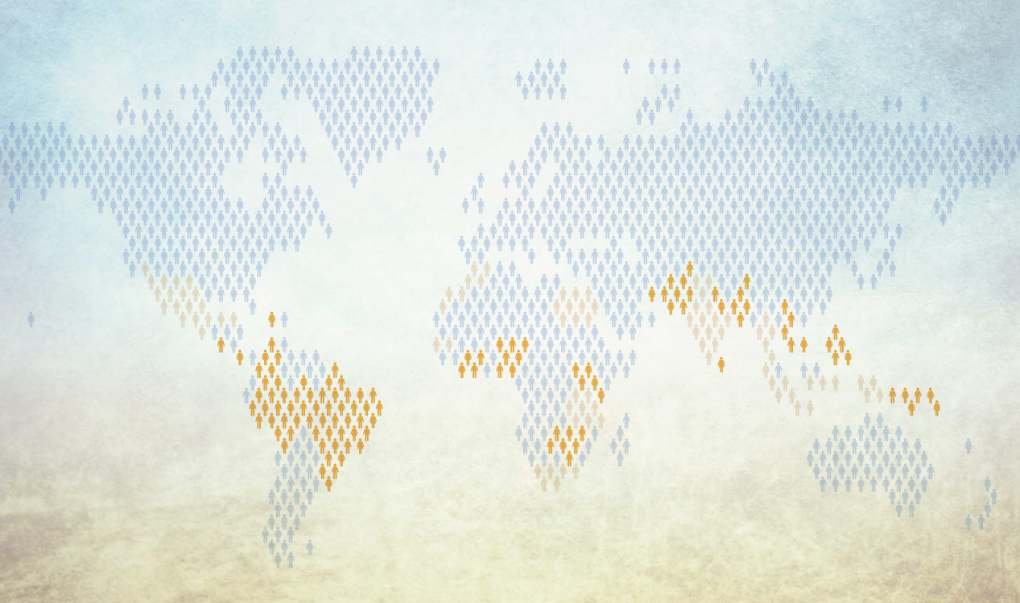

The Landscape of Microinsurance 2022:
Key Findings with a focus on
risks affecting food security in Africa
Stephanie Soedjede
Africa Regional Manager
Microinsurance Network

Slide 2



Estimated share of the population and market value captured in the countries covered
Knowledge sharing – Learning – Networking
Activities
550+
members
The Landscape of microinsurance
Best Practice Groups
Building the resilience of smallholder farmers, Health Microinsurance, Making Insurance work for women, MSME Insurance, Landscape study
>50
countries
Network Exchange/Country reports
Events : Expert Forums / Members meetings / Workshops
92
institutions

Slide 3


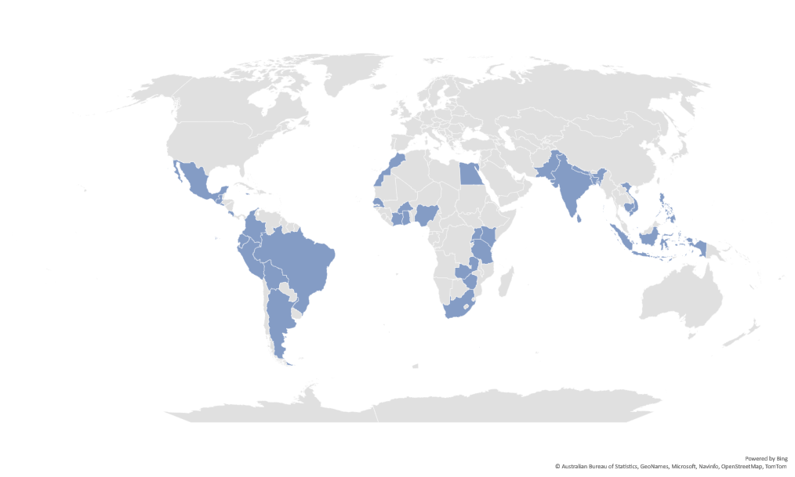
What is the “Landscape” study ?

Slide 4
What is the “Landscape” study ?
Products reported
Respondents
Countries covered

Slide 5
The people protection gap
Based on data from the 34 countries covered in the 2022 Landscape research, only up to 8% of emerging consumers had any form of insurance cover.
Affluent
Affluent
Int. $ 20/day
Low and middle income
68%
Int. $ 2/day
Poor
Poor

Slide 6

Being inclusive: about microinsurance
Premium levels are proportionate to the risks insured.
We use the term interchangeably with ‘inclusive insurance’.
Insurance that is developed specifically to serve the needs of emerging consumers.
For the purposes of this study, the term microinsurance covers all products that fit within this definition and may therefore include products that are not considered as microinsurance by a national insurance supervisor, given that such definitions vary from one country to another.

Slide 7

Key results
Estimated share of the population and market value captured in the countries covered
ESTIMATED SHARE OF THE POPULATION AND MARKET VALUE CAPTURED IN THE COUNTRIES COVERED
Where
# people reached
% emerging consumers reached
Value of premiums
% estimated market value captured
14 African countries
Up to 34.3 million
Up to 8%
US$ 9.1 bn
11%
9 Asian countries
Up to 134.6 million
Up to 7%
US$ 15.9 bn
2%
11 LAC countries
Up to 53.8 million
Up to 13%
US$ 5.8 bn
14%
34 countries overall
Up to 222.7 million
Up to 8%
US$ 30.9 bn
7%
These markets are far from saturated, representing a business opportunity and a development necessity

Slide 8
Product mix – S&E Africa
Estimated share of the population and market value captured in the countries covered

Slide 9
Product mix – S&E Africa
Estimated share of the population and market value captured in the countries covered

Slide 10
Product mix – N&W Africa
Estimated share of the population and market value captured in the countries covered

Slide 11
Product mix - N&W Africa
Estimated share of the population and market value captured in the countries covered

Slide 12



Agriculture risks coverage
In the 34 countries covered, 8 million people received protection for agriculture, aquaculture and livestock through a microinsurance product.
  0.8m in Africa, 2.2m in LAC and 5m in Asia
Branch of interest to governments and donors and frequently offered with subsidies – but not always !
  10% of products reported in the three regions as 100% subsidised
  2% in Africa, 20% in Asia and 40% in LAC
Five out of eight new products index-based.

Slide 13
Agriculture risks coverage
Most agriculture products are linked directly with natural perils and disasters.
Agriculture products covers bundled with additional, secondary risks, including life (for almost 10% of products), property or hospital cash covers.
Insurers are increasingly recognizing the non-agricultural risks faced by smallholder farmers, as well as the relationship between climate and people’s well-being, and exploring bundled covers for farmers.
  3 climate insurance products including hospital cash covers, covering around 680,000 people collectively.

Slide 14
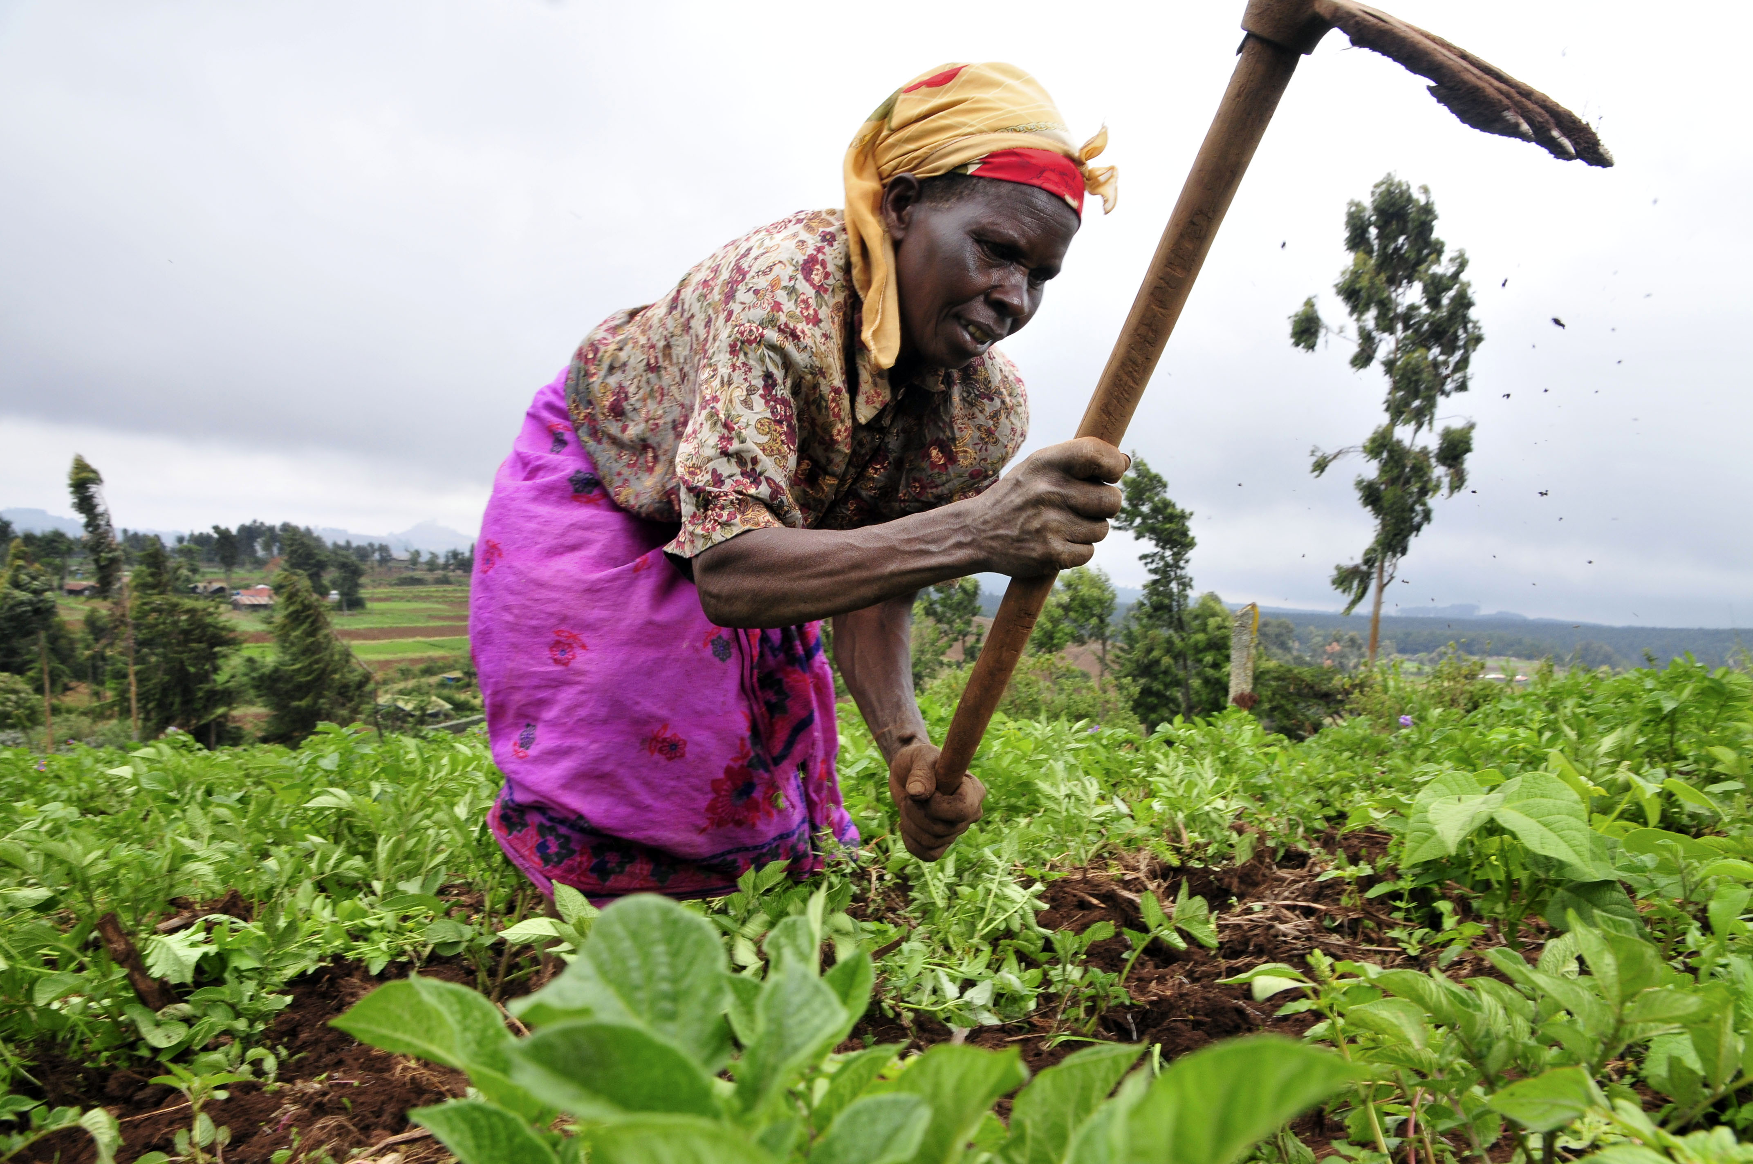
L’ORÉAL, AXA, OLVEA, SONAR - COVERING CLIMATE AND
PERSONAL RISKS FOR WOMEN FARMERS IN BURKINA FASO
  L’Oréal sources shea butter from smallholder farmers, the majority of whom are women, organised in cooperatives in Burkina Faso.
  AXA and L’Oréal with the support of OLVEA and SONAR worked closely with the farmers to understand their risks and developed an innovative product covering both climate and personal risks.
    weather risks affecting maize production, the most important crop for the food security of these households
    health and accident risks.

Slide 15
L’ORÉAL, AXA, OLVEA, SONAR - COVERING CLIMATE AND
PERSONAL RISKS FOR WOMEN FARMERS IN BURKINA FASO
  The covers are adapted to the circumstances of the farmers.
  For example, given the poor access to health facilities in rural areas where shea butter producers live, the product includes cover for the costs of transport to clinics or hospitals.
  Furthermore, AXA continued to refine the product based on customer feedback since it was launched in 2021.
    Malaria cover, for example, was recently introduced based on demand from the farmers.
Cooperatives
L’Oréal
Farmers
Almost 21,000 women reached the first year

Slide 16
Download the 2022 Landscape report at
www.microinsurancenetwork.org
  Premiums and risks covered
  Distribution and payments channels
  Social performance indicators
  Additional case studies
  Women’s access to agriculture microinsurance
  Reinsurance

Slide 17
Data collection for the 2023 Landscape report has started.
Preliminary findings will be presented at the
ICII 2023, 23-27 October 2023, Accra-Ghana
Help us build the knowledge base around microinsurance !
For more information on the Landscape Study or if you would like to provide data, let’s connect:
ssoedjede@microinsurancenetwork.org

Slide 18
Thank you !

